Slide 1
Unit 4
Contents
Transaction Management
Concurrency Control
Recovery Management
Distributed database management systems

Slide 2
Transaction Management
A transaction is a unit of program execution that accesses and possibly updates various data items.
E.g. transaction to transfer $50 from account A to account B:
1. read(A)
2. A := A – 50
3. write(A)
4. read(B)
5. B := B + 50
write(B)
Two main issues to deal with:
Failures of various kinds, such as hardware failures and system crashes
Concurrent execution of multiple transactions

Slide 3
ACID Properties
A transaction is a unit of program execution that accesses and possibly updates various data items. To preserve the integrity of data the database system must ensure:
Atomicity. Either all operations of the transaction are properly reflected in the database or none are.
Consistency. The consistency property ensures that the database remains in a consistent state before the start of the transaction and after the transaction is over (whether successful or not). Any data written to the database must be valid according to all defined rules.
Isolation. Isolation refers to the requirement that other operations cannot access or see the data in an intermediate state during a transaction. Although multiple transactions may execute concurrently, each transaction must be unaware of other concurrently executing transactions. Intermediate transaction results must be hidden from other concurrently executed transactions.
Durability. After a transaction completes successfully, the changes it has made to the database persist, even if there are system failures.

Slide 4
Requirements for Database Consistency
Concurrency Control
Most DBMS are multi-user systems.
The concurrent execution of many different transactions submitted by various users must be organised such that each transaction does not interfere with another transaction with one another in a way that produces incorrect results.
The concurrent execution of transactions must be such that each transaction appears to execute in isolation.
Recovery
System failures, either hardware or software, must not result in an inconsistent database

Slide 5
Transaction as a Recovery Unit
If an error or hardware/software crash occurs between the begin and end, the database will be inconsistent. The errors may be:
Computer Failure (system crash)
A transaction or system error
Local errors or exception conditions detected by the transaction
Concurrency control enforcement
Disk failure
Physical problems and catastrophes.
The database is restored to some state from the past so that a correct state—close to the time of failure—can be reconstructed from the past state.
A DBMS ensures that if a transaction executes some updates and then a failure occurs before the transaction reaches normal termination, then those updates are undone.
The statements COMMIT and ROLLBACK (or their equivalent) ensure Transaction Atomicity

Slide 6
Transaction States
Active – the initial state; the transaction stays in this state while it is executing
Partially committed – after the final statement has been executed.
Failed -- after the discovery that normal execution can no longer proceed.
Aborted – after the transaction has been rolled back and the database restored to its state prior to the start of the transaction. Two options after it has been aborted:
restart the transaction
can be done only if no internal logical error
kill the transaction
Committed – after successful completion.

Slide 7
Transaction States Diagram
BEGIN
END
TRANSACTION
TRANSACTION
active
partially
COMMIT
committed
committed
,
ROLLBACK
ROLLBACK
READ
WRITE
failed
terminated
7

Slide 8
Log Based Recovery
A transaction log is a record in a DBMS that keeps track of all the transactions of a database system that update any values in the database.
A log is kept on stable storage.
The log is a sequence of log records, and maintains a record of update activities on the database.
When transaction T_{i} starts, it registers itself by writing a <T_{i} start>log record
When T_{i} finishes it last statement, the log record <T_{i} commit> is written.
A log file contains:
A Transaction begin marker
Transaction Id and user Id
Operation performed by the user
Data items affected
Before (old) values
After (new) values
Commit marker of the transaction

Slide 9
Log Based Recovery
Consider following 3 transactions:
TI | T2 | T3
Read X | Read A | Read Z
Sub 100 | Add 200 | Sub 500
Write X | Write A | Write Z
Read Y
Add 100
Write Y

Slide 10
Log Based Recovery
Following log record describes the status of the transaction when failure occurred
Recovery will be done as follows
Trans Marker | Id | Oper | Undo values | Redo values | Commit marker
Y | T1 | Sub X Add Y | 500 800 | 400 Not Done | N
Y | T2 | Add A | 1000 | 1200 | N
Y | T3 | Sub Z | 900 | 400 | Y
Values | Initial | Before failure | Oper required | Recovered Values
X | 500 | 400 | Undo | 500
Y | 800 | 800 | Undo | 800
A | 1000 | 1200 | Undo | 1000
Z | 900 | 400 | Redo | 400

Slide 11
Log Based Recovery
Undo portion is required when partial updates made by an uncommitted transaction needs to be undone.
Redo portion is required when failure occurs after the transaction has finished its execution.
The following graph shows the status of various transactions when failure occurred:
T1 and T2 will be redone whereas T3 and T4 will be undone.
T1
T2
T3 Failure
T4

Slide 12
Other Log based recovery techniques
Checkpoints
Deferred Mechanisms

Slide 13
Checkpoints
The simple ‘write ahead strategy’ (or log recovery) examines all records for those transactions and it redoes all those transactions that have been committed even hours earlier. So to improve this situation checkpoint mechanism is used.
Using this scheme, only uncommitted transactions that started before the checkpoint but did not commit, are considered or that started after the checkpoint.

Slide 14
Checkpoints
During recovery we need to consider only the most recent transaction T_{i} that started before the checkpoint, and transactions that started after T_{i}.
Scan backwards from end of log to find the most recent <checkpoint> record
Continue scanning backwards till a record <T_{i} start> is found.
Need only consider the part of log following above start record. Earlier part of log can be ignored during recovery, and can be erased whenever desired.
For all transactions (starting from T_{i} or later) with no <T_{i} commit>, execute undo(T_{i}). (Done only in case of immediate modification.)
Scanning forward in the log, for all transactions starting from T_{i} or later with a <T_{i} commit>, execute redo(T_{i}).

Slide 15
Example of Checkpoints
T_{c}
T_{f}
T₁ can be ignored (updates already output to disk due to checkpoint)
T₂ and T₃ redone.
T₄ undone
T₁
T₂
T₃
T₄
checkpoint
system failure

Slide 16
Deferred modification scheme
It ensures transaction atomicity by recording all database modifications in the log, but deferring the write operations until the transaction partially commits.
The deferred database modification scheme records all modifications to the log, but defers all the writes to after partial commit.
Assume that transactions execute serially
Transaction starts by writing <T_{i} start> record to log.
A write(X) operation results in a log record <T_{i}, X, V> being written, where V is the new value for X
Note: old value is not needed for this scheme
The write is not performed on X at this time, but is deferred.
When T_{i} partially commits, <T_{i} commit> is written to the log
Finally, the log records are read and used to actually execute the previously deferred writes.

Slide 17
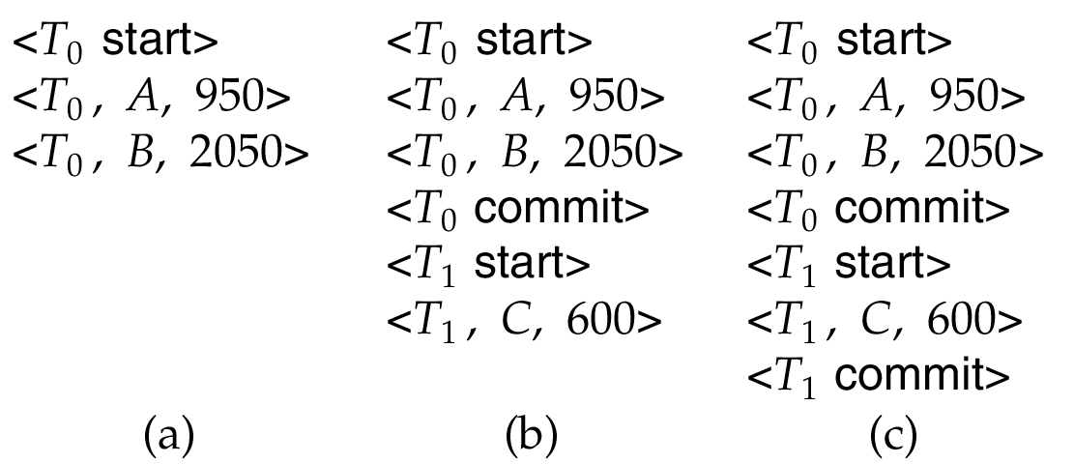
Deferred modification scheme
Below we show the log as it appears at three instances of time.
If log on stable storage at time of crash is as in case:
(a) No redo actions need to be taken
(b) redo(T₀) must be performed since <T₀ commit> is present
(c) redo(T₀) must be performed followed by redo(T₁) since
<T₀ commit> and <T_{i} commit> are present

Slide 18
Shadow Paging
Shadow paging is an alternative to log-based recovery; this scheme is useful if transactions execute serially
Idea: maintain two page tables during the lifetime of a transaction –the current page table, and the shadow page table
Store the shadow page table in nonvolatile storage, such that state of the database prior to transaction execution may be recovered.
Shadow page table is never modified during execution
To start with, both the page tables are identical. Only current page table is used for data item accesses during execution of the transaction.
Whenever any page is about to be written for the first time
A copy of this page is made onto an unused page.
The current page table is then made to point to the copy
The update is performed on the copy

Slide 19
Shadow Paging
to be deleted
Old copy
of database
new copy
of database

Slide 20
Shadow Paging (Cont.)
To commit a transaction :
1. Flush all modified pages in main memory to disk
2. Output current page table to disk
3. Make the current page table the new shadow page table, as follows:
keep a pointer to the shadow page table at a fixed (known) location on disk.
to make the current page table the new shadow page table, simply update the pointer to point to current page table on disk
Once pointer to shadow page table has been written, transaction is committed.
No recovery is needed after a crash — new transactions can start right away, using the shadow page table.
Pages not pointed to from current/shadow page table should be freed (garbage collected).

Slide 21
Shadow Paging (Cont.)
Advantages of shadow-paging over log-based schemes
no overhead of writing log records
recovery is trivial
Disadvantages :
Copying the entire page table is very expensive
Can be reduced by using a page table structured like a B⁺-tree
No need to copy entire tree, only need to copy paths in the tree that lead to updated leaf nodes
Commit overhead is high even with above extension
Need to flush every updated page, and page table
Data gets fragmented (related pages get separated on disk)
After every transaction completion, the database pages containing old versions of modified data need to be garbage collected

Slide 22
Concurrency Control
Multiple transactions are allowed to run concurrently in the system. Advantages are:
increased processor and disk utilization, leading to better transaction throughput
E.g. one transaction can be using the CPU while another is reading from or writing to the disk
reduced average response time for transactions: short transactions need not wait behind long ones.
Concurrency control schemes – mechanisms to achieve isolation
that is, to control the interaction among the concurrent transactions in order to prevent them from destroying the consistency of the database

Slide 23
Schedules
Schedule – a sequences of instructions that specify the chronological order in which instructions of concurrent transactions are executed
a schedule for a set of transactions must consist of all instructions of those transactions
must preserve the order in which the instructions appear in each individual transaction.
A transaction that successfully completes its execution will have a commit instructions as the last statement
by default transaction assumed to execute commit instruction as its last step
A transaction that fails to successfully complete its execution will have an abort instruction as the last statement

Slide 24
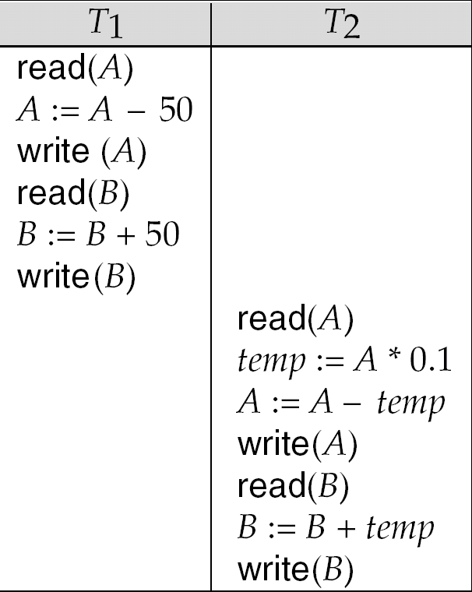
Schedule 1
Let T₁ transfer $50 from A to B, and T₂ transfer 10% of the balance from A to B.
A serial schedule in which T₁ is followed by T₂ :

Slide 25
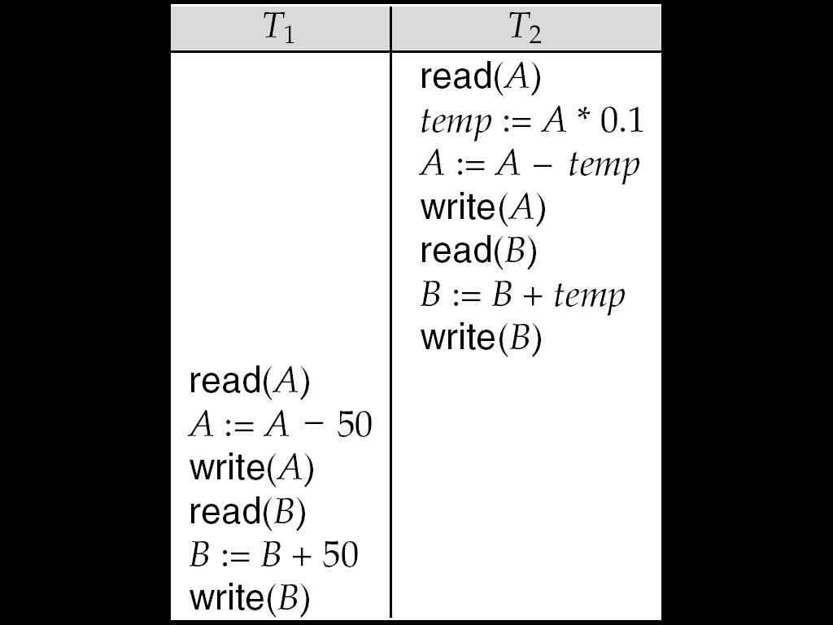
Schedule 2
A serial schedule where T₂ is followed by T₁

Slide 26
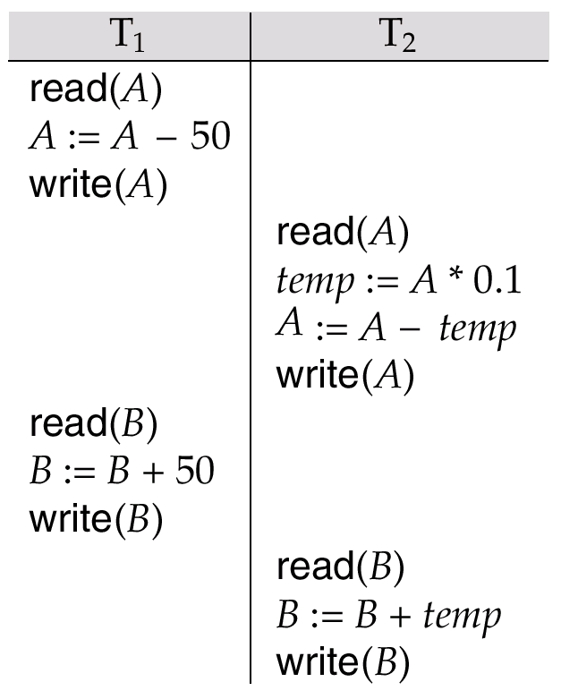
Schedule 3
Let T₁ and T₂ be the transactions defined previously. The following schedule is not a serial schedule, but it is equivalent to Schedule 1.
In Schedules 1, 2 and 3, the sum A + B is preserved.

Slide 27
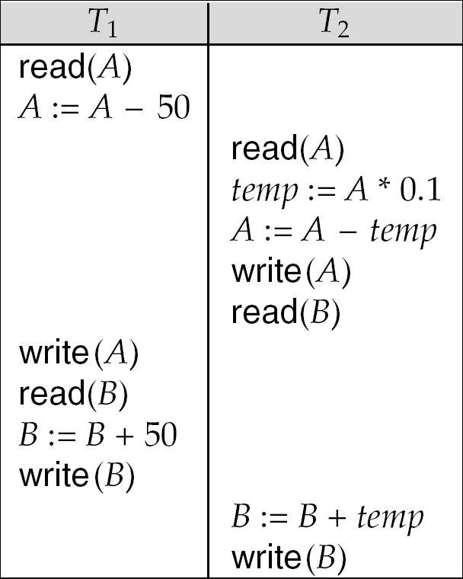
Schedule 4
The following concurrent schedule does not preserve the value of (A + B ).

Slide 28
Serializability
Basic Assumption – Each transaction preserves database consistency.
Thus serial execution of a set of transactions preserves database consistency.
A (possibly concurrent) schedule is serializable if it is equivalent to a serial schedule. Different forms of schedule equivalence give rise to the notions of:
1. conflict serializability
2. view serializability
Simplified view of transactions
We ignore operations other than read and write instructions
We assume that transactions may perform arbitrary computations on data in local buffers in between reads and writes.
Our simplified schedules consist of only read and write instructions.

Slide 29
Transaction scheduling algorithms
Transaction Serializability
The effect on a database of any number of transactions executing in parallel must be the same as if they were executed one after another
Problems due to the Concurrent Execution of Transactions
The Lost Update Problem
The Incorrect Summary or Unrepeatable Read Problem
The Temporary Update (Dirty Read) Problem
≡

Slide 30
The Lost Update Problem
Two transactions accessing the same database item have their
operations interleaved in a way that makes the database item incorrect
Assume:
X=4
N=2
M=3
Y=8
Item X has incorrect value because its update from T1 is “lost” (overwritten)
T2 reads the value of X before T1 changes it in the database and hence the updated
database value resulting from T1 is lost

Slide 31
The Incorrect Summary or Unrepeatable Read Problem
One transaction is calculating an aggregate summary function on a number of records while other transactions are updating some of these records.
The aggregate function may calculate some values before they are updated and others after.
T1: | T2: | T1 | T2 | Sum
 | sum:= 0; |  |  | 0
 | read_item(A); |  | 4
 | sum:= sum + A; |  |  | 4
read_item(X);. | . | 4
X:= X - N; | . | 2
write_item(X); |  | 2
 | read_item(X); |  | 2
 | sum:= sum + X; |  |  | 6
 | read_item(Y); |  | 8
 | sum:= sum + Y; |  |  | 14
read_item(Y); |  | 8
Y:= Y + N; |  | 10
write_item(Y); |  | 10
T2 reads X after N is subtracted and reads Y before N is added, so a wrong summary is the result

Slide 32
Dirty Read or The Temporary Update Problem
One transaction updates a database item and then the transaction fails. The updated item is accessed by another transaction before it is changed back to its original value
T1: (partha) | T2: (pg) | Database | Log old | Log new
read_item(X); |  | 4
X:= X - N; |  | 2
write_item(X); |  | 2 | 4 | 2
 | read_item(X); | 2
 | X:= X- N; | 0
 | write_item(X); | 0 | 2 | 0
failed write (X) |  | 4 | rollback T1 log
transaction T1 fails and must change the value of X back to its old value
meanwhile T2 has read the “temporary” incorrect value of X

Slide 33
Example of Serial Schedules
Schedule B
Schedule A
T1: | T2:
read_item(X);
X:= X - N;
write_item(X);
read_item(Y);
Y:=Y + N;
write_item(Y);
 | read_item(X);
 | X:= X + M;
 | write_item(X);
T1: | T2:
 | read_item(X);
 | X:= X + M;
 | write_item(X);
read_item(X);
X:= X - N;
write_item(X);
read_item(Y);
Y:=Y + N;
write_item(Y);

Slide 34
Example of Non-serial Schedules
Schedule D
Schedule C
T1: | T2:
read_item(X);
X:= X - N;
 | read_item(X);
 | X:= X + M;
write_item(X);
read_item(Y);
 | write_item(X);
Y:=Y + N;
write_item(Y);
T1: | T2:
read_item(X);
X:= X - N;
write_item(X);
 | read_item(X);
 | X:= X + M;
 | write_item(X);
read_item(Y);
Y:=Y + N;
write_item(Y);
We have to figure out whether a schedule is equivalent to a serial schedule
i.e. the reads and writes are in the right order

Slide 35
Conflicting Instructions
Instructions l_{i} and l_{j} of transactions T_{i} and T_{j} respectively, conflict if and only if there exists some item Q accessed by both l_{i} and l_{j}, and at least one of these instructions wrote Q.
1. l_{i} = read(Q), l_{j} = read(Q). l_{i} and l_{j} don’t conflict. 2. l_{i} = read(Q), l_{j} = write(Q). They conflict. 3. l_{i} = write(Q), l_{j} = read(Q). They conflict 4. l_{i} = write(Q), l_{j} = write(Q). They conflict
Intuitively, a conflict between l_{i} and l_{j} forces a (logical) temporal order between them.
If l_{i} and l_{j} are consecutive in a schedule and they do not conflict, their results would remain the same even if they had been interchanged in the schedule.

Slide 36
Conflict Serializability
If a schedule S can be transformed into a schedule S´ by a series of swaps of non-conflicting instructions, we say that S and S´ are conflict equivalent.
We say that a schedule S is conflict serializable if it is conflict equivalent to a serial schedule

Slide 37
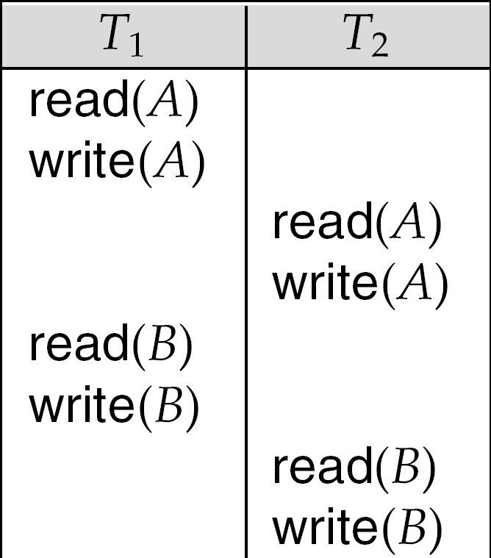
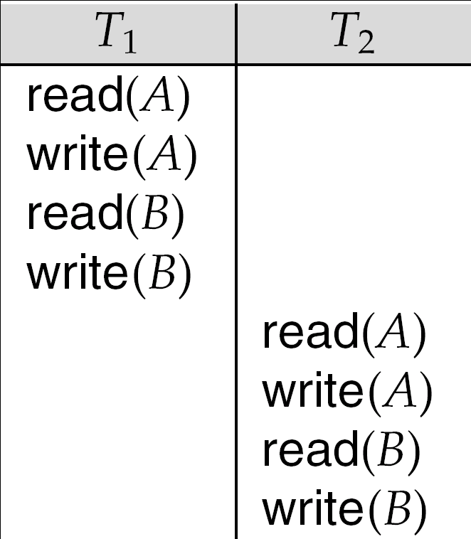
Conflict Serializability (Cont.)
Schedule 3 can be transformed into Schedule 6, a serial schedule where T₂ follows T₁, by series of swaps of non-conflicting instructions.
Therefore Schedule 3 is conflict serializable.
Schedule 3
Schedule 6

Slide 38
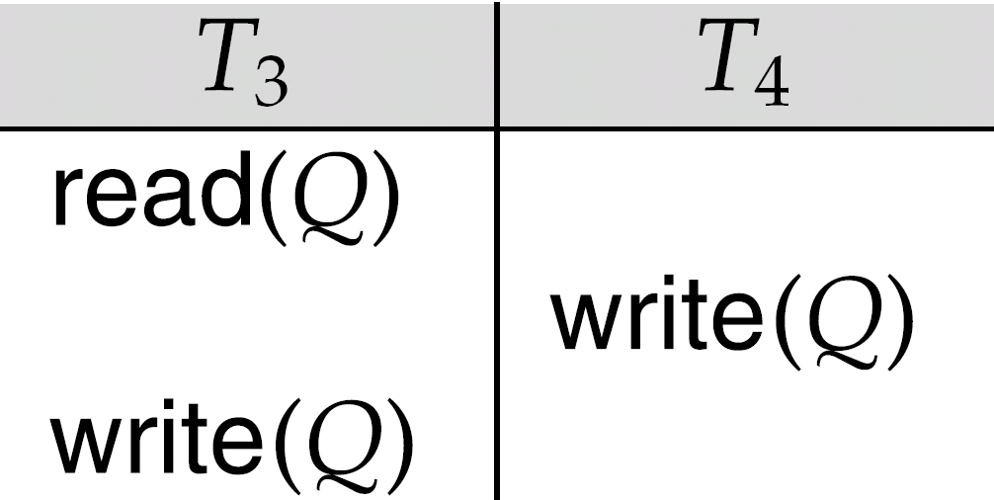
Conflict Serializability (Cont.)
Example of a schedule that is not conflict serializable:
We are unable to swap instructions in the above schedule to obtain either the serial schedule < T₃, T₄ >, or the serial schedule < T₄, T₃ >.

Slide 39
View Serializability
Let S and S´ be two schedules with the same set of transactions. S and S´ are view equivalent if the following three conditions are met, for each data item Q,
If in schedule S, transaction T_{i} reads the initial value of Q, then in schedule S’ also transaction T_{i} must read the initial value of Q.
If in schedule S transaction T_{i} executes read(Q), and that value was produced by transaction T_{j} (if any), then in schedule S’ also transaction T_{i} must read the value of Q that was produced by the same write(Q) operation of transaction T_{j} .
The transaction (if any) that performs the final write(Q) operation in schedule S must also perform the final write(Q) operation in schedule S’.

Slide 40
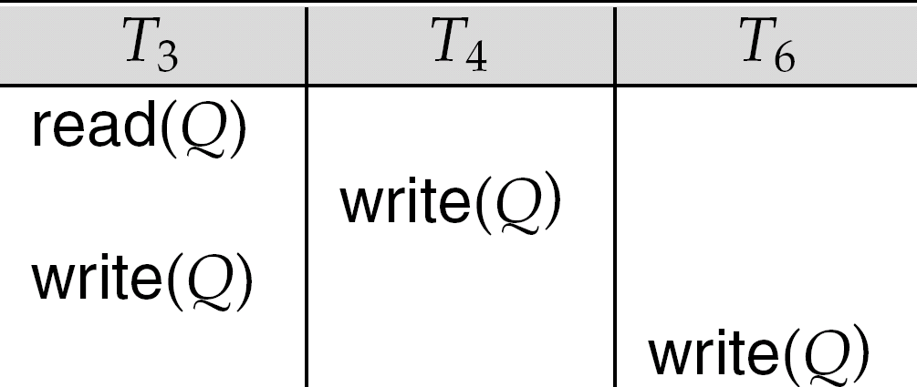
View Serializability (Cont.)
A schedule S is view serializable if it is view equivalent to a serial schedule.
Every conflict serializable schedule is also view serializable.
Below is a schedule which is view-serializable but not conflict serializable.
What serial schedule is above equivalent to?
Every view serializable schedule that is not conflict serializable has blind writes.

Slide 41
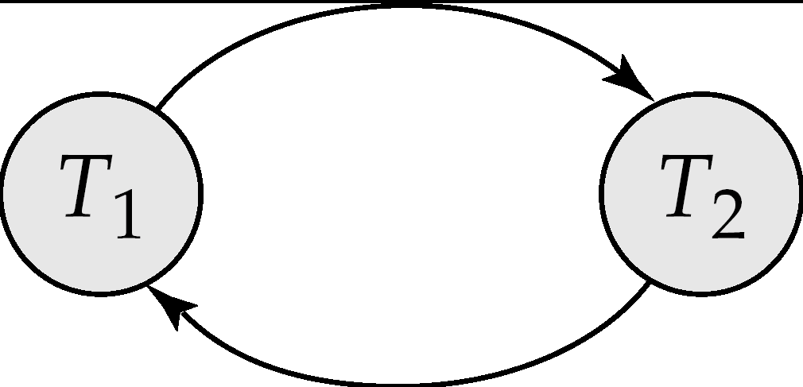
Testing for Serializability
Consider some schedule of a set of transactions T₁, T₂, ..., T_{n}
Precedence graph — a direct graph where the vertices are the transactions (names).
We draw an arc from T_{i} to T_{j} if the two transaction conflict, and
Tj performs READ to read the value written by Ti, OR
Tj performs WRITE after Ti performs READ / WRITE.
We may label the arc by the item that was accessed.
Example 1
x
y

Slide 42
Example Schedule (Schedule A) + Precedence Graph
T₁ T₂ T₃ T₄ T₅ read(X) read(Y) read(Z) read(V) read(W) read(W) read(Y) write(Y) write(Z) read(U) read(Y) write(Y) read(Z) write(Z)
read(U) write(U)
T₁
T₂
T₄
T₃
T₅

Slide 43
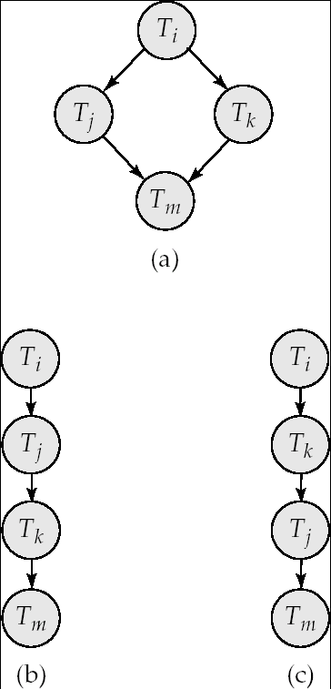
Test for Conflict Serializability
A schedule is conflict serializable if and only if its precedence graph is acyclic.
Cycle-detection algorithms exist which take order n² time, where n is the number of vertices in the graph.
(Better algorithms take order n + e where e is the number of edges.)
If precedence graph is acyclic, the serializability order can be obtained by a topological sorting of the graph.
This is a linear order consistent with the partial order of the graph.
For example, a serializability order for Schedule A would be T₅ → T₁ → T₃ → T₂ → T₄
Are there others?

Slide 44
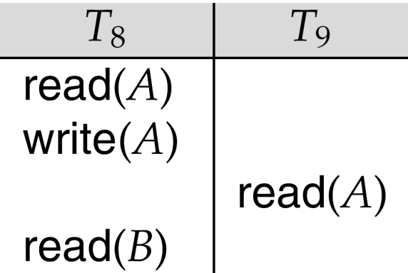
Recoverable Schedules
Need to address the effect of transaction failures on concurrently running transactions.
Recoverable schedule — if a transaction T_{j} reads a data item previously written by a transaction T_{i} , then the commit operation of T_{i} appears before the commit operation of T_{j}.
The following schedule (Schedule 11) is not recoverable if T₉ commits immediately after the read
If T₈ should abort, T₉ would have read (and possibly shown to the user) an inconsistent database state. Hence, database must ensure that schedules are recoverable.

Slide 45
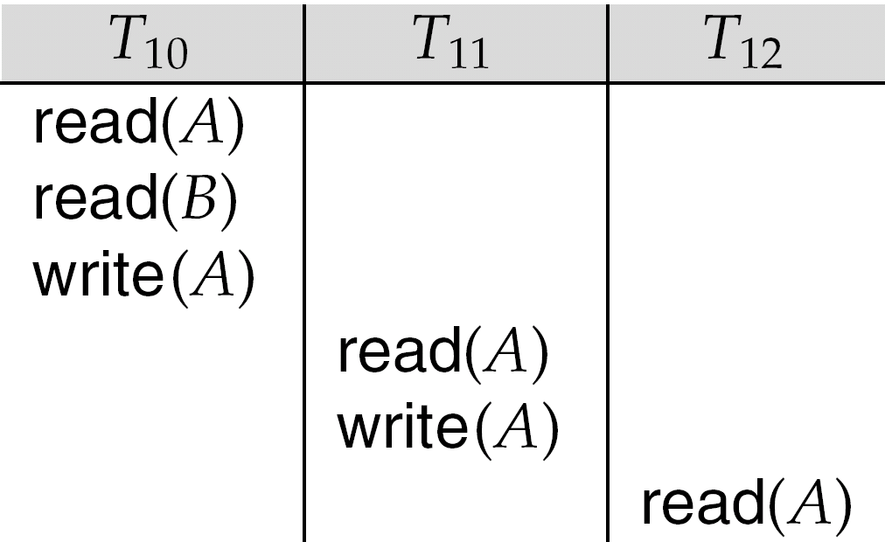
Cascading Rollbacks
Cascading rollback – a single transaction failure leads to a series of transaction rollbacks. Consider the following schedule where none of the transactions has yet committed (so the schedule is recoverable) If T₁₀ fails, T₁₁ and T₁₂ must also be rolled back.
Can lead to the undoing of a significant amount of work

Slide 46
Cascadeless Schedules
Cascadeless schedules — cascading rollbacks cannot occur; for each pair of transactions T_{i} and T_{j} such that T_{j} reads a data item previously written by T_{i}, the commit operation of T_{i} appears before the read operation of T_{j}.
Every cascadeless schedule is also recoverable
It is desirable to restrict the schedules to those that are cascadeless

Slide 47
Concurrency Control Mechanisms
Lock Based Protocols
Timestamp Based Protocols
Tree (or Graph) Based Protocols
Deadlock handling techniques

Slide 48
Locking Schemes
To ensure serializability, it is required that when one transaction is accessing a data item no other transaction can modify it.
There are 2 ways to lock a data item:
Shared lock (Read mode)
Exclusive lock (Write mode)
Shared locks are compatible with only other shared locks and not with exclusive locks.

Slide 49
Starvation
Starvation may occur due to 2 reasons:
Allowing a higher priority trans to acquire lock may result in starvation of lower priority trans waiting for an x lock.
When a shared lock is acquired by a series of trans on a data item and at the same time any other trans is waiting for x-lock on it.

Slide 50
Solution to Starvation
When a trans Ti requests a lock on data item Q, the concurrency ctrl manager grants the lock only when:
There is no other trans holding a conflicting lock.
There is no other trans which is waiting for a lock on Q and made lock request before Ti.

Slide 51
2 PL
There are two phases in which a trans holds and releases a lock on a data item:
Phase 1: Growing Phase
transaction may obtain locks
transaction may not release locks
Phase 2: Shrinking Phase
transaction may release locks
transaction may not obtain locks
Problems with 2 PL:
It does not ensure freedom from deadlocks
Cascading rollbacks may occur.
Cascading rollbacks can be avoided by
Strict 2PL
Rigorous 2P

Slide 52
Example:
T1
Lock X (A) ---------------------------- Growing Phase
Read A
Lock S (B)
Read B
:
:
Unlock X (A) ---------------------------- Shrinking Phase
Unlock S (B)

Slide 53
Problems with 2PL
T1 T2 T3
Lock X(A)
Read A
Lock S(B)
Read B
Write A
Unlock (A)
Lock X(A)
Read A
Write A
Unlock (A)
Lock S(A)
Read A
:
:
Write B
-----------FAILURE_____________

Slide 54
Strict 2PL requires that all exclusive locks taken by a transaction be held until the transaction commits. In other words, a transaction can release exclusive locks only after it is committed.
Rigorous 2PL requires that all locks (whether shared or exclusive) be held by a transaction until it commits.

Slide 55
Lock Conversions
Lock conversion strategy is used by 2PL for converting alock from one mode to another.
The mechanism of converting a shared lock into exclusive mode is called upgrading.
Whereas converting a lock from exclusive mode to shared mode is called downgrading.
Upgrading always take place in growing phase and downgrading in shrinking phase.
Example : If a transaction needs a data item Q in exclusive mode at the end, then it is better to initially lock Q in shared mode ( so that other transactions can access it) and at the end upgrade it to exclusive mode.

Slide 56
Lock Conversions
Two-phase locking with lock conversions:
– First Phase:
can acquire a lock-S on item
can acquire a lock-X on item
can convert a lock-S to a lock-X (upgrade)
– Second Phase:
can release a lock-S
can release a lock-X
can convert a lock-X to a lock-S (downgrade)
This protocol assures serializability. But still relies on the programmer to insert the various locking instructions.

Slide 57
Timestamp-Based Protocols
Each transaction is issued a timestamp when it enters the system. If an old transaction T_{i} has time-stamp TS(T_{i}), a new transaction T_{j} is assigned time-stamp TS(T_{j}) such that TS(T_{i}) <TS(T_{j}).
The protocol manages concurrent execution such that the time-stamps determine the serializability order.
In order to assure such behavior, the protocol maintains for each data Q two timestamp values:
W-timestamp(Q) is the largest time-stamp of any transaction that executed write(Q) successfully.
R-timestamp(Q) is the largest time-stamp of any transaction that executed read(Q) successfully.

Slide 58
Timestamp-Based Protocols
The timestamp ordering protocol ensures that any conflicting read and write operations are executed in timestamp order.
Suppose a transaction T_{i} issues a read(Q)
1. If TS(T_{i}) ≤ W-timestamp(Q), then T_{i} needs to read a value of Q
that was already overwritten. Hence, the read operation is
rejected, and T_{i} is rolled back.
2. If TS(T_{i})≥ W-timestamp(Q), then the read operation is
executed, and R-timestamp(Q) is set to the maximum of R-
timestamp(Q) and TS(T_{i}).

Slide 59
Timestamp-Based Protocols
Suppose that transaction T_{i} issues write(Q).
If TS(T_{i}) < R-timestamp(Q), then the value of Q that T_{i} is producing was needed previously, and the system assumed that that value would never be produced. Hence, the write operation is rejected, and T_{i} is rolled back.
Otherwise, the write operation is executed, and W-timestamp(Q) is set to TS(T_{i}).

Slide 60
Correctness of Timestamp-Ordering Protocol
The timestamp-ordering protocol guarantees serializability since all the arcs in the precedence graph are of the form:
Thus, there will be no cycles in the precedence graph
Timestamp protocol ensures freedom from deadlock as no transaction ever waits.
But the schedule may not be cascade-free, and may not even be recoverable.
transaction
with smaller
timestamp
transaction
with larger
timestamp

Slide 61
Recoverability and Cascade Freedom
Problem with timestamp-ordering protocol:
Suppose T_{i} aborts, but T_{j} has read a data item written by T_{i}
Then T_{j} must abort; if T_{j} had been allowed to commit earlier, the schedule is not recoverable.
Further, any transaction that has read a data item written by T_{j} must abort
This can lead to cascading rollback --- that is, a chain of rollbacks
Solution:
A transaction is structured such that its writes are all performed at the end of its processing
All writes of a transaction form an atomic action; no transaction may execute while a transaction is being written
A transaction that aborts is restarted with a new timestamp

Slide 62
Graph-Based Protocols
Graph-based protocols are an alternative to two-phase locking
Impose a partial ordering → on the set D = {d₁, d₂ ,..., d_{h}} of all data items.
If d_{i} → d_{j} then any transaction accessing both d_{i} and d_{j} must access d_{i} before accessing d_{j}.
Implies that the set D may now be viewed as a directed acyclic graph, called a database graph.
The tree-protocol is a simple kind of graph protocol.

Slide 63
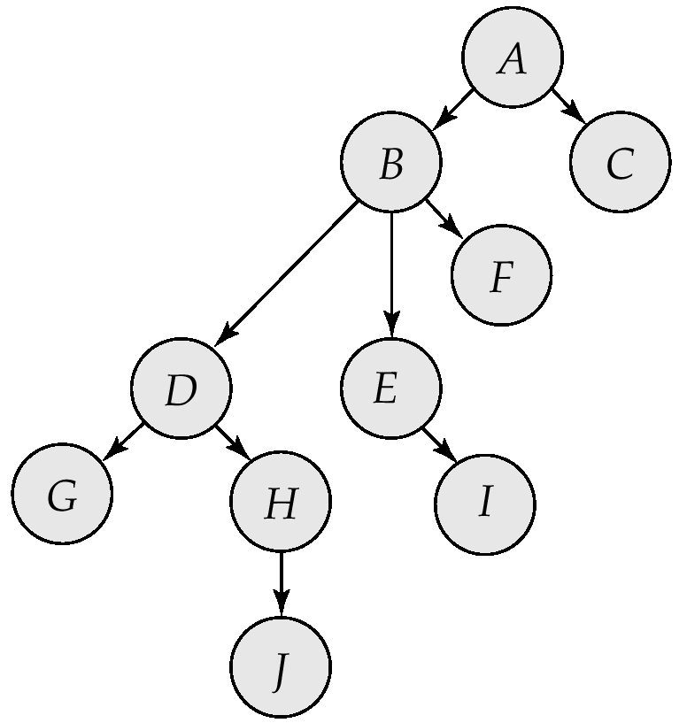
Tree Protocol
RULES
Only exclusive locks are allowed.
Each Ti can lock a data item at most once.
The first lock by T_{i} may be on any data item. Subsequently, a data Q can be locked by T_{i} only if the parent of Q is currently locked by T_{i}.
Data items may be unlocked at any time.

Slide 64
Tree Protocol
Some Examples : Partial order on the data
LXB; LXE; UNE; LXD; UNB; LXG; UND; UNG.
•LXD; LXH; UND; LXJ; UNJ; UNH.
•LXB; LXE; UNE; UNB.
•LXD; LXH; UND; UNH.

Slide 65
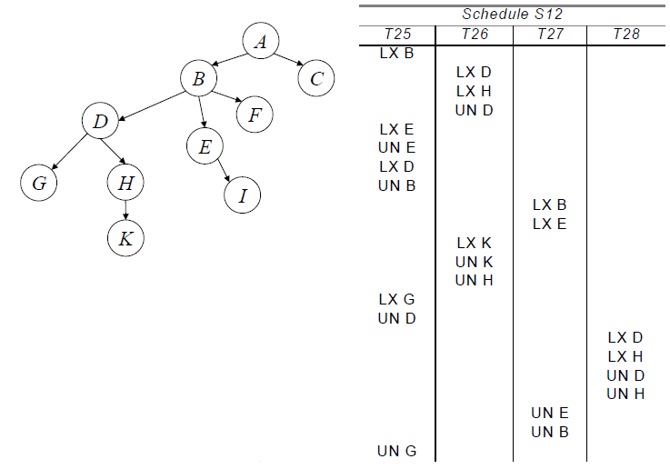
Tree Protocol

Slide 66
Tree Protocol
The tree protocol ensures conflict serializability as well as freedom from deadlock.
Unlocking may occur earlier in the tree-locking protocol than in the two-phase locking protocol. (Advantages)
shorter waiting times, and increase in concurrency
protocol is deadlock-free, no rollbacks are required
However, in the tree-locking protocol, a transaction may have to lock data items that it does not access. (Disadvantages)
increased locking overhead, and additional waiting time
potential decrease in concurrency
the abort of a transaction can still lead to cascading rollbacks.
Schedules not possible under two-phase locking are possible under tree protocol.

Slide 67
Deadlock Handling
T₁
T₂
lock-X on X
write (X)
lock-X on Y
write (X)
wait for lock-X on X
wait for lock-X on Y
Consider the following two transactions:
T₁: write (X) T₂: write(Y)
write(Y) write(X)
Schedule with deadlock

Slide 68
Deadlock Handling
System is deadlocked if there is a set of transactions such that every transaction in the set is waiting for another transaction in the set.
Deadlock prevention protocols ensure that the system will never enter into a deadlock state. Some prevention strategies :
Require that each transaction locks all its data items before it begins execution (predeclaration).
Impose partial ordering of all data items and require that a transaction can lock data items only in the order specified by the partial order (graph-based protocol).

Slide 69
More Deadlock Prevention Strategies
Following schemes use transaction timestamps for the sake of deadlock prevention alone.
Wait-die scheme
Wound -wait scheme
wait-die scheme — non-preemptive
When transaction Ti requests a data item held by Tj, then Ti is allowed to wait only if it has a smaller timestamp than Tj i.e. Ti is older than Tj, otherwise Ti is rolled back.
If TS(Ti) < TS(Tj), then Ti waits else Ti dies.
older transaction may wait for younger one to release data item. Younger transactions never wait for older ones; they are rolled back.
For example:
Suppose that transaction T₂₂, T₂₃, T₂₄ have time-stamps 22, 23 and 24 respectively. If T₂₂ requests a data item held by T₂₃ then T₂₂ will wait. If T₂₄ requests a data item held by T₂₃, then T₂₄ will be rolled back.

Slide 70
wound-wait scheme — preemptive
When transaction Ti requests a data item held by Tj, Ti is allowed to wait only if it has a timestamp larger than Tj otherwise Tj will be rolled back. (Tj is wounded by Ti).
If TS(Ti) < TS(Tj), then Tj is wounded by Ti, else Ti waits.
older transaction wounds (forces rollback) of younger transaction instead of waiting for it. Younger transactions may wait for older ones.
For example:
Suppose that Transactions T₂₂, T_{23,} T₂₄ have time-stamps 22, 23 and 24 respectively . If T₂₂ requests a data item held by T₂₃, then data item will be preempted from T₂₃ and T₂₃ will be rolled back. If T₂₄ requests a data item held by T₂₃, then T₂₄ will wait.

Slide 71
Deadlock prevention (Cont.)
Timeout-Based Schemes :
a transaction waits for a lock only for a specified amount of time. After that, the wait times out and the transaction is rolled back.
thus deadlocks are not possible
simple to implement; but starvation is possible. Also difficult to determine good value of the timeout interval.

Slide 72
Deadlock Detection
Deadlocks can be described as a wait-for graph, which consists of a pair G = (V,E),
V is a set of vertices (all the transactions in the system)
E is a set of edges; each element is an ordered pair T_{i} →T_{j}.
If T_{i} → T_{j} is in E, then there is a directed edge from T_{i} to T_{j}, implying that T_{i} is waiting for T_{j} to release a data item.
When T_{i} requests a data item currently being held by T_{j}, then the edge T_{i} T_{j} is inserted in the wait-for graph. This edge is removed only when T_{j} is no longer holding a data item needed by T_{i}.
The system is in a deadlock state if and only if the wait-for graph has a cycle. Must invoke a deadlock-detection algorithm periodically to look for cycles.

Slide 73
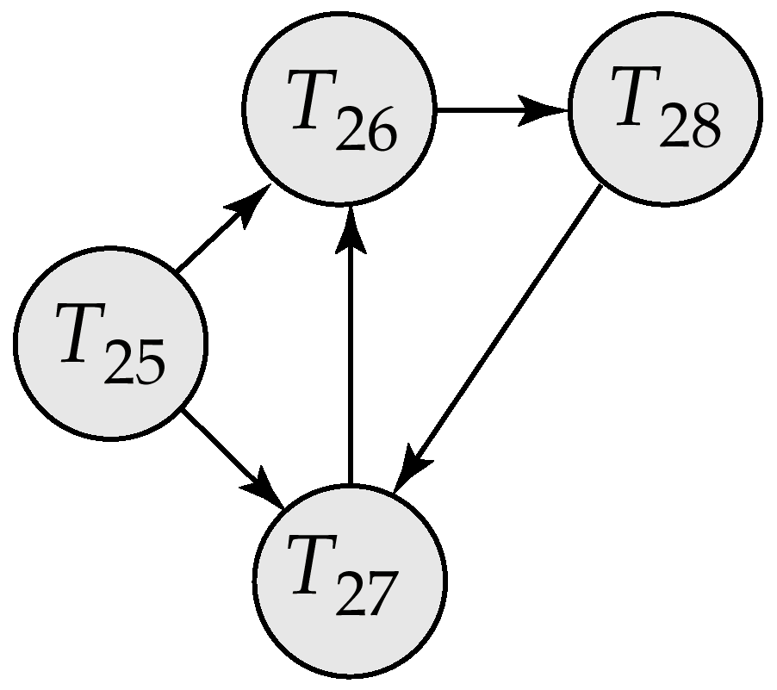
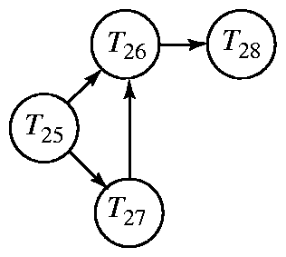
Deadlock Detection (Cont.)
Wait-for graph without a cycle
Wait-for graph with a cycle

Slide 74
Deadlock Recovery
When deadlock is detected :
Some transaction will have to rolled back (made a victim) to break deadlock. Select that transaction as victim that will incur minimum cost.
Rollback -- determine how far to roll back transaction
Total rollback: Abort the transaction and then restart it.
More effective to roll back transaction only as far as necessary to break deadlock.
Starvation happens if same transaction is always chosen as victim. Include the number of rollbacks in the cost factor to avoid starvation

Slide 75
Multiple Granularity
Allow data items to be of various sizes and define a hierarchy of data granularities, where the small granularities are nested within larger ones
Can be represented graphically as a tree (but don't confuse with tree-locking protocol)
When a transaction locks a node in the tree explicitly, it implicitly locks all the node's descendents in the same mode.
Granularity of locking (level in tree where locking is done):
fine granularity (lower in tree): high concurrency, high locking overhead
coarse granularity (higher in tree): low locking overhead, low concurrency

Slide 76
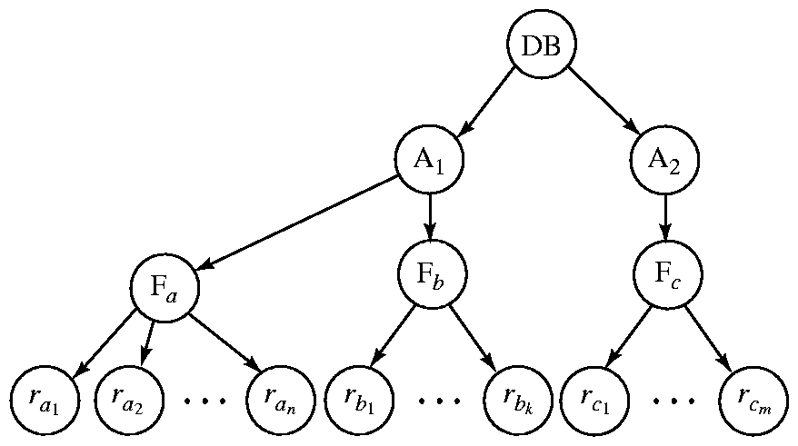
Example of Granularity Hierarchy
The highest level in the example hierarchy is the entire database.
The levels below are of type area, file and record in that order.

Slide 77
Distributed Databases
A distributed database is a collection of data that belong logically to the same system but are spread over the sites of a computer network
It consists of loosely coupled sites that share no physical components.

Slide 78
Key Objective of Distributed Databases
It looks like a centralized system to the user and the user does not need to know where a piece of data is actually stored physically.
The two important aspects of a distributed system are:
Distribution
Logical Correlation

Slide 79
Local databases vs Distributed Databases
Local Applications : are completely executed by the computer of the branch where it is implemented and it needs to access only the database of the same branch.
Global Applications : access data that exist at more than one branch.

Slide 80
Features of distributed vs centralized Databases
Centralized Control : In DDBMS, it is less emphasized.
Data Independence : Achieved through distribution transparency.
Redundancy : Not guaranteed. Instead replicas are maintained to achieve availability of data and to reduce communication overhead.
Integrity, recovery and concurrency control : Difficult to implement as compared to centralized systems. Distributed locking protocols are used.
Privacy and security.

Slide 81
Why Distributed Databases?
Interconnection of existing databases
Incremental growth
Reduced communication overhead
Performance considerations
Reliability and availability
Organizational reasons

Slide 82
Disadvantages of Distributed Databases
Complexity
Cost
Distribution of control
Security
Lack of standards
Difficult to change

Slide 83
Components of Distributed Database systems
Computer workstations (nodes or sites)
Network components
Communication media
Transaction manager / processor
Data Processor

Slide 84
Forms of Data Distribution
There are 2 imporatat forms of distributed data
1. Data Fragmentation: The decomposition of global relations into fragments is called data fragmentation.
2. Replicated Data : Storing copies of data at multiple sites.
There are two forms of replication :
1. Fully replicated databases
2. Partially replicated databases.

Slide 85
Data Fragmentation
There are 3 rules which must be considered when defining fragments:
Completeness condition
Reconstruction condition
Disjoint condition

Slide 86
Types of Fragmentation
There are 3 types of data fragmentation:
Horizontal fragmentation
Vertical fragmentation
Mixed fragmentation

Slide 87
Transparency
Data transparency means the user of DBMS should not be required to know where the data are physically located and how the data can be accessed at the specific site.
It can take 3 forms
Fragmentation transparency
Replication transparency
Location transparency

Slide 88
Reference Architecture of Distributed Databases
Global Schema
Site independent schemas
Fragmentation Schema
Allocation Schema
Local mapping Schema1
Local mapping Schema N
Local schemas may be hetrogeneous
DBMS of site1
DBMS of site2
Local database at site1
Local database at site N

Slide 89
Questions
What are Concurrent transactions?
What are different concurrency control mechanisms?
What is shadow paging?
What is the difference between Log based recovery and checkpoint mechanism.
What is a data warehouse? Why it is called that the data warehouses are subject oriented and time variant?
What is data mining?

